Slide 1



Ratio of Dyslexic Students and Specialized Support Teachers in Inclusive and
Non-Inclusive Primary Schools
Keyword : Dyslexia

Slide 2





Rahma Hayati
Speaker

Slide 3




Background
Definition
Dyslexia is a learning disorder that can hinder academic progress. This neurological condition impacts the brain's ability to process language and recognize written symbols, resulting in reading, writing, and spelling challenges. Understanding dyslexia is vital for offering effective support and creating inclusive learning environments.

Slide 4
Background
Prevalence
Dyslexics often encounter significant barriers to learning, which can result in lower comprehension and slower learning speeds compared to their peers (Olson et al., 2014). These challenges may lead to dyslexics being unfairly labeled as lazy, unmotivated, slow learners, or late bloomers. Consequently, they may begin to doubt their intellectual capabilities. However, it is important to note that individuals with dyslexia possess normal intellectual capacity (Serrano & Defior, 2008), and there is no direct correlation between their disorder and their level of intelligence.

Slide 5
Background
Solution
Dyslexia is a learning disorder, not a disease, and can be managed through personalized education plans and effective interventions. Support from skilled educators, family, and peers is essential. The intervention process must be structured and ongoing, as the brain can reorganize itself (Lefly & Pennington, 1991; Eckert et al., 2003; Hulme & Snowling, 2016).

Slide 6

Background
The framework for inclusive schools has been established by the Ministry of Education and Culture, yet the reality on the ground reveals significant gaps in execution. A critical issue identified by (Garnida, 2015) is that many inclusive schools lack the necessary educators who are trained and skilled in implementing effective inclusive education. This shortfall not only hinders the delivery of personalized learning programs but also significantly impacts vital interventions for students, particularly those with dyslexia. We must address these challenges to ensure that every student receives the support they deserve.

Slide 7

Background
The prevalence of dyslexic students and GPKs (specialized support teachers) in Indonesia for 2024 remains unknown. To address this gap, the researcher conducted a comprehensive survey. The findings will provide valuable insights for the public and raise awareness about dyslexia and special needs education. This research aims to inspire innovative solutions and systemic changes to improve support for these students.

Slide 8





Method
This research employs a quantitative approach through a carefully designed survey method. Survey research offers a powerful quantitative analysis of behaviors, trends, and phenomena within a population by studying a representative sample (Creswell, 2019). The goal of this research is to generalize findings across the larger population based on the samples studied, allowing for conclusions to be drawn from the conducted research.

Slide 9
Method
The research was conducted between August 9 and September 13, 2024, and involved 158 respondents, including both principals and teachers. These individuals represented 132 inclusive and non-inclusive primary schools from throughout Indonesia. The details regarding the respondents are summarized in the table below, highlighting the diverse perspectives that contributed to this important study.

Slide 10
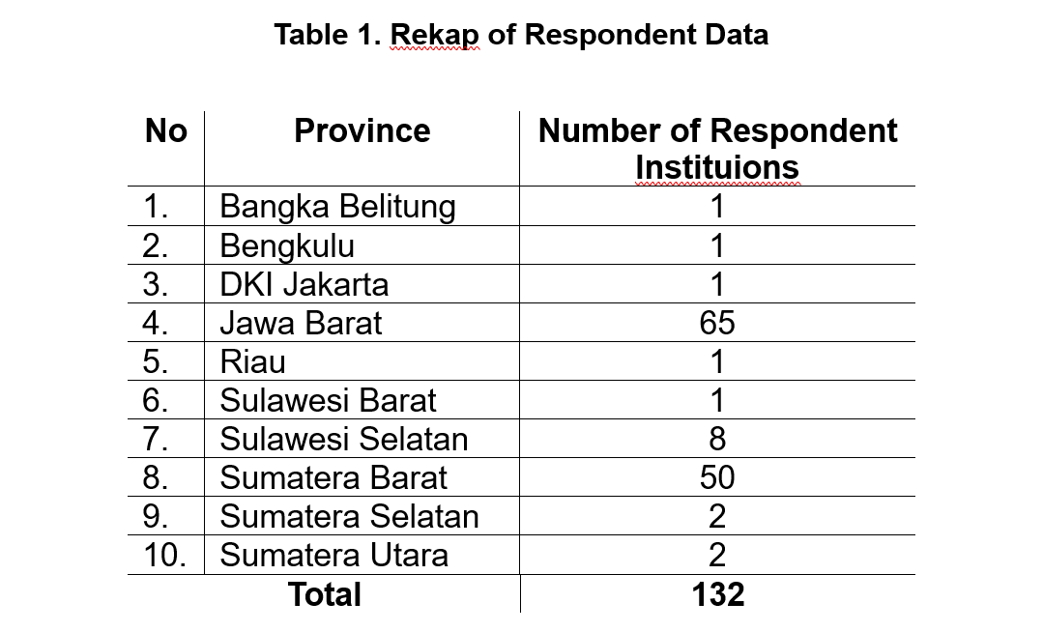
Method
This research is dedicated to delivering a precise analysis and strategic adaptation for enhancing future research designs. By systematically analyzing data from 158 respondents, we will uncover valuable insights into the average distribution of dyslexic students and specialized support teachers (GPKs) in primary schools throughout Indonesia, ultimately fostering better educational outcomes.

Slide 11
Result and Discussion
Result
The analysis indicates that there are, on average, about 2 dyslexic students in both inclusive and non-inclusive primary schools. This is significant, as a study by the International Dyslexia Association (IDA) and Shaywitz & Shaywitz (2020) reveals that 5% to 17% of school-age children are affected by dyslexia, or roughly one in ten. It is essential to address the needs of these students to create an inclusive learning environment.

Slide 12
Result and Discussion
Result
The data highlights a troubling gap: of the 40 inclusive primary schools, only 11 have a GPK (specialized support teachers), while just 2 of the 92 non-inclusive schools do. With an average of only one GPK in inclusive schools, this disparity hinders personalized learning and effective interventions for dyslexic students. We must advocate for more resources to ensure all students receive the support they need.

Slide 13
Conclusion
To effectively support dyslexic students, it is vital to enhance the understanding of principals and primary school teachers regarding appropriate interventions. This involvement ensures that all educators, not just specialized support teachers (GPK), play a role in the process. Garnida (2015) emphasizes that inclusive education offers significant benefits to teachers by fostering their professional growth in skills, perspectives, and teaching methodologies. Embracing this understanding will ultimately enrich the learning experience for all students.

Slide 14



International Conference on Elementary Education
Thanks You
Speaker: Rahma Hayati

