Slide 1
DEVELOPMENT OF TEACHING MATERIALS DISCOVERY LEARNING USING GROUP WORK TECHNIQUES FOR READING COMPREHENSION OF CLASS IV STUDENTS OF NORTH JAKARTA PRIMARY SCHOOL
Muhamad Romadhon
NIM : 9919920005
POSTGRADUATETHE STATE UNIVERSITY OF JAKARTA
2024
State University of Jakarta

Slide 2
The PISA report released on Tuesday, December 3, 2019, related to Indonesia's reading score, ranked 72 out of 77 countries. (low)
State University
of Jakarta
The results of the initial test on reading ability filled out by 72 respondents of grade IV students, obtained an average score of 17.29 (still far below the KKM = 65)
The results of simple observations through questionnaires in North Jakarta show that the type of teaching materials used are still predominantly printed books.
Effective learning materials are needed to improve students' reading comprehension skills.
Introduction
02

Slide 3
State University
of Jakarta
How is the process of developing learning materials based on discovery learning to improve the reading comprehension skills of grade IV elementary school students in Indonesian language subjects?
01.
Formulation of The Problem
How to design learning activities for students' reading comprehension skills with discovery learning in elementary school grade IV students in Indonesian language subjects?
02.
03.
How appropriate is the learning material based on discovery learning to improve the reading comprehension skills of grade IV elementary school students in Indonesian language subjects?
04.
How effective is discovery learning-based learning materials for the reading comprehension skills of grade IV elementary school students in Indonesian language subjects?
03

Slide 4
Research Purposes
State University
of Jakarta
01.
02.
03.
04.
To produce a conceptual model and physical model of learning materials based on discovery learning to improve the reading comprehension skills of grade IV elementary school students in the Indonesian language subject.
To determine the feasibility of discovery learning-based learning materials on the reading comprehension skills of grade IV elementary school students in the Indonesian language subject.
To determine the effectiveness of discovery learning-based learning materials on the reading comprehension skills of grade IV elementary school students in the Indonesian language subject.
To produce alternative learning materials as a solution to improve reading comprehension skills using the discovery learning approach.
04

Slide 5
Research Methods
State University
of Jakarta
Type of research: Research & development. with the research and development model using the Instructional Design model Dick n Carry
2
Instructional analysis
1
Needs analysis
3
Learning Analysis context
8
4
Formulation Performance Objective
9
5
Developing assessment instruments
6
7
10
Realizingthe revision
Designing and conducting summative evaluations
develop learning strategies
develop and select materials
Conducting formative evaluation
05

Slide 6
Small Group Trial Results
State University
of Jakarta
The average Pre-Test is 58.67 while the average Post-Test score shows an average score of 81.00. This means that Indonesian language learning based on discovery learning has succeeded in improving students' reading comprehension skills.
Small Group Pre-Test and Post-Test Results
There are differences between classes that implement discovery learning-based Indonesian language learning and classes that do not implement discovery learning-based Indonesian language learning.
The results of the correlation calculation of the Pre-Test and Post-Test
Small Group
A significant value (2-taled) < 0.05 was found, namely 0.000, so it can be concluded that there is a significant influence between the Pre-Test and Post-Test.
Results of Paired Pre-Test and Post-Test Small Group T-Test Samples
06

Slide 7
Field Trial Results (SDN Sunter Jaya 03)
State University
of Jakarta
The research data is normally distributed with significant values ​​of Kolmogorov Smirnov and Shapiro-Wilk test > 0.05, and the Sig Pre-Test value of the experimental class is 0.116 > 0.05 while the Sig Post-Test value of the experimental class shows 0.200 > 0.05.
Normality Test Results
The research data is normally distributed with significant values ​​of Kolmogorov Smirnov and Shapiro-Wilk test > 0.05, and the Sig Pre-Test value of the experimental class is 0.116 > 0.05 while the Sig Post-Test value of the experimental class shows 0.200 > 0.05.
Paired sample T-Test Results
07

Slide 8
Continued.. Field Trial Results (SDN Sunter Jaya 03)
State University
of Jakarta
The output results show that the significant value (sig) base on mean is 0.311 > 0.05 so it can be concluded that the variance of the experimental class data and the control class post-test data is the same/homogeneous.
Homogeneity Test Results
shows a significant value of Sig (2-tailed) of 0.003 < 0.05, meaning that there is a difference in the average results of reading comprehension skills between students who receive discovery learning-based lessons with group work techniques, and students who do not receive discovery learning lessons with group work techniques.
Independent Sample T-Test Results
08

Slide 9
Field Trial Results (East Pademangan Elementary School 01)
State University
of Jakarta
there is a pre-test value of the experimental class of 0.14 > 0.05 while the value of the experimental class shows 0.11 > 0.05. It can be concluded that the research data is normally distributed so that it can be used in the assessment of the parametric sample test and the independent sample t test.
Hasil Uji Normalitas
The results of the paired sample t-test showed significant Pair-1 with a total of 0.000 <0.05, meaning that there is a difference in reading comprehension ability between the pre-test and post-test experimental classes. In Pair-2, a significant value was obtained with details of 0.000 <0.05, meaning that there is a difference in the average results of students' reading comprehension ability on the pre-test of the control class and the post-test of the control class.
Hasil Uji Paired sample T-Test
09

Slide 10
Continued.. Field Trial Results (SDN Pademangan Timur 01)
State University
of Jakarta
Homogeneity Test Results
The value of the homogeneity of variance test shows that the significant value in (based on man) is 0.318 > 0.05 so that it can be concluded that the variance of the experimental class data and the control class data is the same or homogeneous.Independent Sample T-Test.
The independent sample t-test data shows a significant sig value output (2-tailed) of 0.000 < 0.05. This means that there is a difference in the average value of reading comprehension ability.
Hasil Uji Independent SampleT-Test

Slide 11
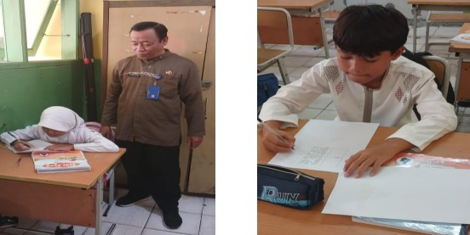
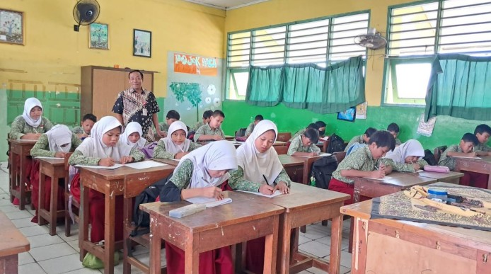
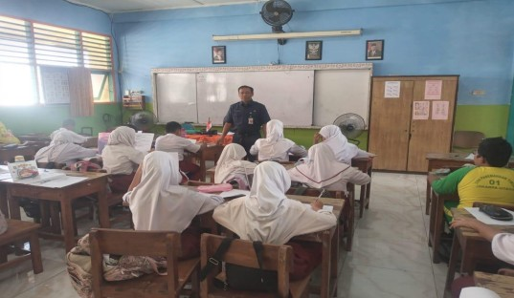
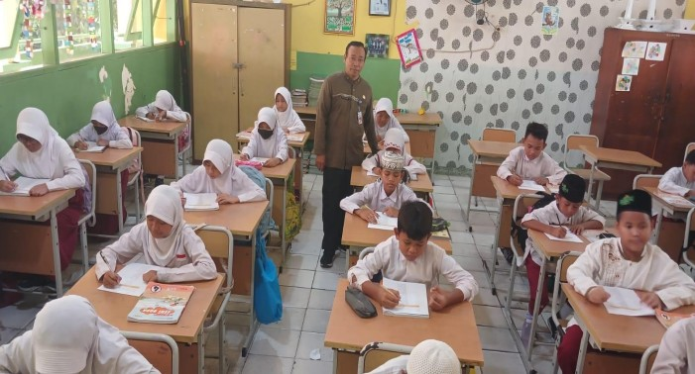
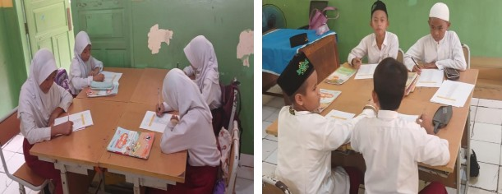
Research Gallery
State University
of Jakarta
Small Group Trial
Field trials
11

Slide 12
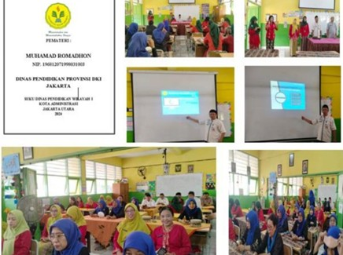
State University
of Jakarta
Research Gallery
Dissemination
11

Slide 13
State University
of Jakarta
Discovery learning-based teaching materials with group work techniques have proven effective in improving the reading comprehension skills of grade IV Elementary School students. This is proven by the results of the t-test sample test which shows that the Pair-1 and Part-2 values ​​are significant from all totals of 0.000 <0.05 for both schools in North Jakarta.
Conclusion
12

Slide 14
Thank You
State University of Jakarta

