Slide 1
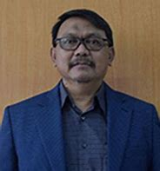

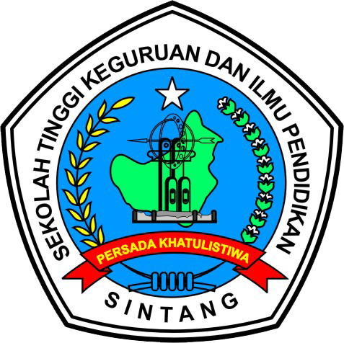



Indigenous Knowledge in The Framework of Ethnopedagogy for Merdeka Curriculum in Elementary Schools
STKIP Persada Khatulistiwa Universitas Pendidikan Indonesia
Bandung-Sintang, November 23th 2024
Research
Team

Slide 2
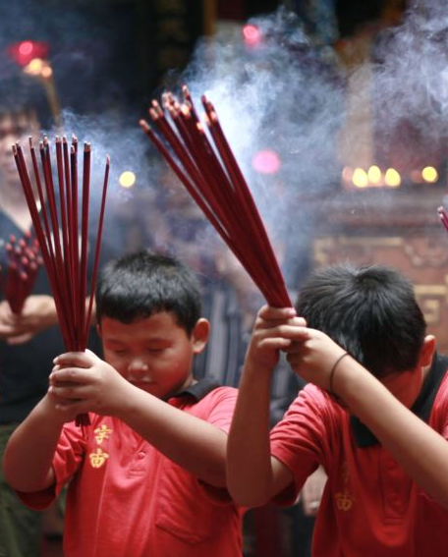

Indigenous Knowledge in The Framework of Ethnopedagogy for Merdeka Curriculum in Elementary Schools
Malay
Dayak
Chinese
Dayak
Dayak
Urgency:
Documentation
Digging the information
Respecting and preserving
Teknologi & Alat
Teknologi & Alat
Sejarah
Technology & Tools
Sejarah
History
https://www.mpr.go.id/
https://www.mpr.go.id/
https://www.mpr.go.id/
Lingkungan Alam & Ekosistem
Lingkungan Alam & Ekosistem
Bahasa
Natural Environment & Ecosystems
Bahasa
Language
myxxgirl.com
myxxgirl.com
by Prayudi nugraha
myxxgirl.com
by Prayudi nugraha
by Prayudi nugraha
Research Fieldwork
Research Fieldwork
Research Fieldwork
Sastra
Sastra
Literature
Obat-obatan
Obat-obatan
Medicines
Indigenous
Knowledge
Purpose:
Screening
Analyze and synthesize
Indigenous
Knowledge
Indigenous
Knowledge
Seni
Seni
Art
Makanan & Minuman
Makanan & Minuman
Food and Beverages
Output:
Indigenous Knowledge
The Frame of Ethnopedagogy
Merdeka Curriculum in Elementary Schools
Busana
Busana
Kerajinan
Fashion
Kerajinan
Crafts
Adat istiadat & Hukum Adat
Olahraga
Adat istiadat & Hukum Adat
Olahraga
Customary Customs & Law
Sports

Slide 3




Indigenous Knowledge in The Framework of Ethnopedagogy for Merdeka Curriculum in Elementary Schools
The diversity of the rich cultural values of the Indonesian nation
Background & Problem Formulation
Problem-Solving Approach
Qualitative Descriptive Research
Undergoing erosion to extinction
Initial Observations
Explorative Survey Approach
Research
Indigenous Knowledge
Dayak,
Malay,
Chinese
Previous Research
12 Indigenous Knowledge
The research is:
How is indigenous knowledge?
How is it implemented in elementary schools?
Potential Screening
Ethnos
Research Roadmap
State of the Art and Novelty
Potential Research
Pedagogy
Dissemination at the Elementary Education Level
Research and Development
Merdeka Curriculum

Slide 4
Indigenous Knowledge in The Framework of Ethnopedagogy for Merdeka Curriculum in Elementary Schools
Primary
Informants
Descriptive
Qualitative
Know
Data Source
Research
Indigenous Knowledge
Dayak,
Malay,
Chinese
Type of Research
Key
Collect
Survey
Explorative
Recomendation
Maintain
Delimiter
Questionnaires
Determining Informants: Purposive Sampling
in-depth interview guidelines
Conduct an Questionnaires, Interviews & Observations
Data Collection
Research Instruments
Data Analysis
Observation sheets
Qualitative Through Activities:
Collection
Reduction
Serving
Drawing conclusions
Qualitative Using the results of questionnaires, interviews & observations
follow-up interview guidelines

Slide 5
Indigenous Knowledge in The Framework of Ethnopedagogy for Merdeka Curriculum in Elementary Schools
Resource of Indigenous Knowledge | Result of Indigenous Knowledge | Resource of Education Practitioner | Results of Ethnopedagogy
Primary Key Rcomendation | History Language Literature Art Crafts Customary Customs and Law Technology and Tools Natural Environment and Ecosystems Medicines Food and Beverages Fashion Sports | Delimiter | In education, Indigenous Knowledge can be part of: a) Subject b) Subject Matter b) Learning Materials c) Contextual Learning d) Learning Activities

Slide 6
Indigenous Knowledge in The Framework of Ethnopedagogy for Merdeka Curriculum in Elementary Schools
Subject | Subject Matter and Learning Materials | Contextual Learning and Learning Activities
Religious Education and Ethics | History of Religious Civilization and local beliefs Values to religion in society | 1) Learning Model 2) Learning Approach 3) Learning Methods 4) Learning Strategies 5) Learning Techniques 6) Learning Tactics
Pancasila Education | Unity within the framework of Bhinneka Tunggal Ika. Tolerance related to SARA (Ethnicity, Religion, Race, Customs)
Bahasa Indonesia | Folklore literacy: Myths, Fairy Tales, and Legends Local Literature: Hikayat, Pantun, Syair, Mantera
Mathematics | Flat build and build space Culture-based math
Natural and Social Sciences | Local animals and Local Plants Local communities
Physical Education, Sports and Health | Traditional Sports Healthy traditional food Traditional herbs
Arts and Culture, including Music, Arts, Theater Arts, Dance Arts | Traditional Music Arts Traditional Dance Arts Traditional Arts Traditional Theatre Arts
English Language | Literacy of folklore in English Local literature in English
Muatan Lokal | Local History Traditional Language Local Literacy Traditional Art Local Crafts Customary Customs and Law Traditional technology and traditional equipment Local natural environment and local ecosystem Traditional Medicines Local Food and Drink Traditional Clothing Traditional Sports

Slide 7
Thank You

